Slide 1
User Generated Content and Product Preference Networks
User Generated Content Analytics
October 3, 2018

Slide 2
Predicting Business Outcomes From User Generated Content
Can UGC (e.g., product reviews) predict business outcomes such as sales and market share?
Often users mention competing products
Can we extract preference information?
Can we draw product comparison (or preference) networks?
Can such networks help predict business outcomes?
Slides based on Zhang et al. (2013) posted on Canvas

Slide 3
From Product Comparisons to Preference Networks
“The B&W P7 are high on my favorite list next to the H8 by B&O and the Grados. I also like the new P5 a lot because their sound is close to the P7 without the bulk.”
“I just love the luxury, style and performance of the Audi A6; the Lexus GS300 is a nice reliable car and a very good value, but lacks the coolness factor.”
+5
5-2 = 3 (weight)
+2
Audi A6
+3
4-3 = 1
+4
Lexus GS300
“I need a super reliable car with the great creature comforts, and while the A6 is a wonderful car, it is quite expensive; the Lexus GS300 is not exactly the lap of luxury, but really fits the bill for me in every way.”

Slide 4
The Main Idea
Directed product networks
Indicate implicit preferences
Relative desirability of a node
A product review (as discussed in the article)
Must mention two or more products
Has two sentiment scores (s₁ and s₂) for two products 1 and 2 respectively.
Arrow between the two product, tip ends on the product with higher sentiment score
Difference in sentiment scores becomes the weight of the arrow
How to put a score on each node which represents its desirability

Slide 5
What Metric Can Capture the Relative Importance of a Product?
Create a network of product preferences
PageRank is one possibility
Developed by Larry Page, Serge Brin & Rajiv Motwani at Stanford
A variation of the good old eigenvector algebra
Based on how many web pages refer to a particular web page.

Slide 6
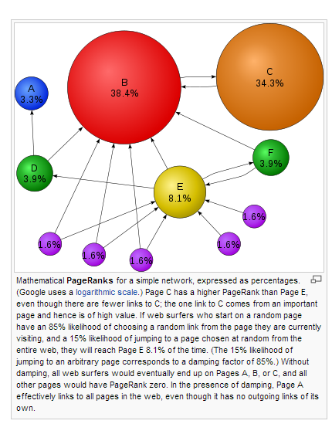
PageRank to the Rescue
If many web pages refer to a page, the latter must be important
If the referring pages are referred to by many other pages, the effect is stronger
Source: Wikipedia

Slide 7
Weighted PageRank
Not all incoming links are created equal
Different ways to create weights on links
networkx library in python can calculate weighted PageRank scores

Slide 8
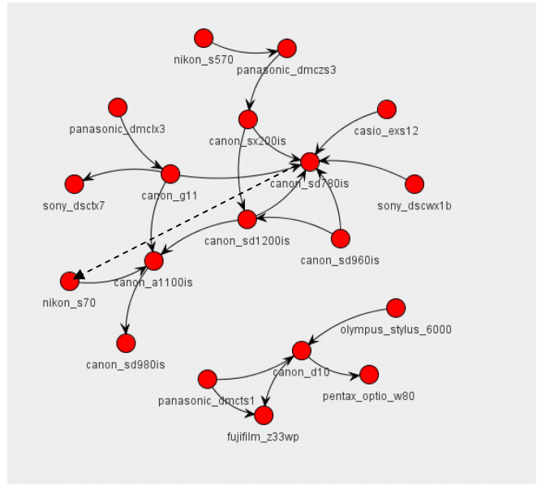
Real World Implications

